Slide 1

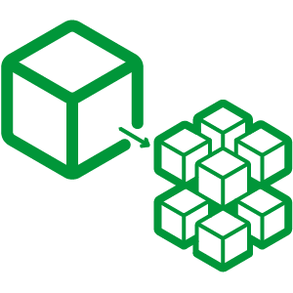

Slide 2
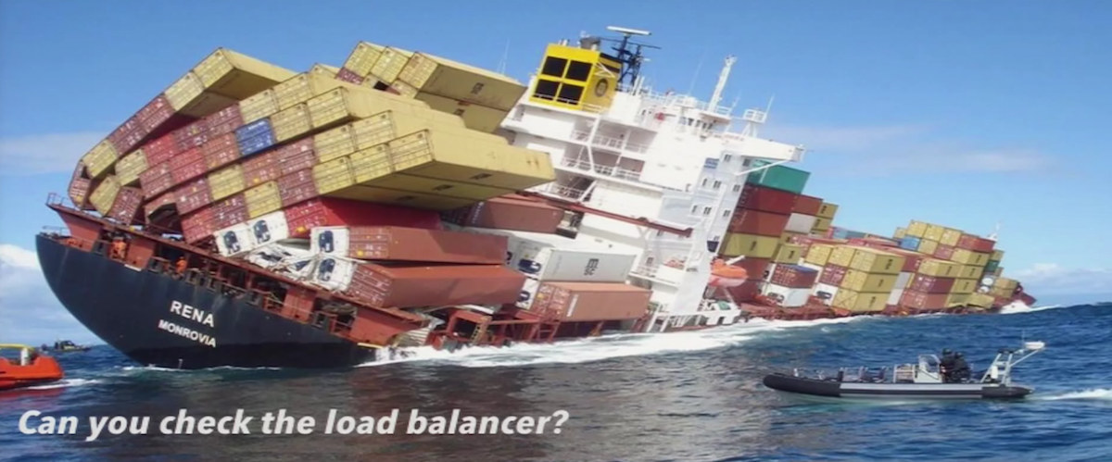
The Monolith

Slide 3
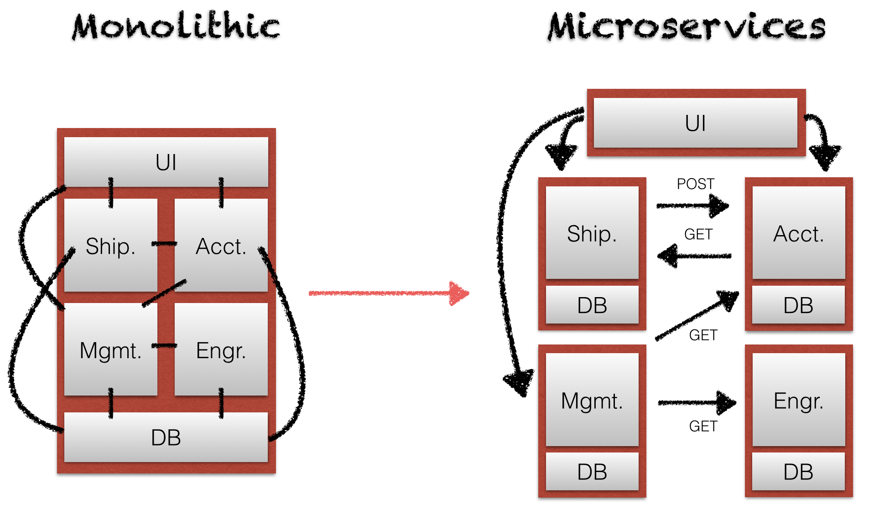
Monolithic or Microservices?

Slide 4
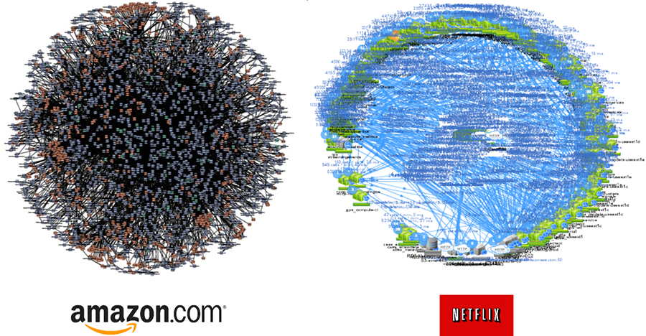
Why Do We Need Microservices?

Slide 5
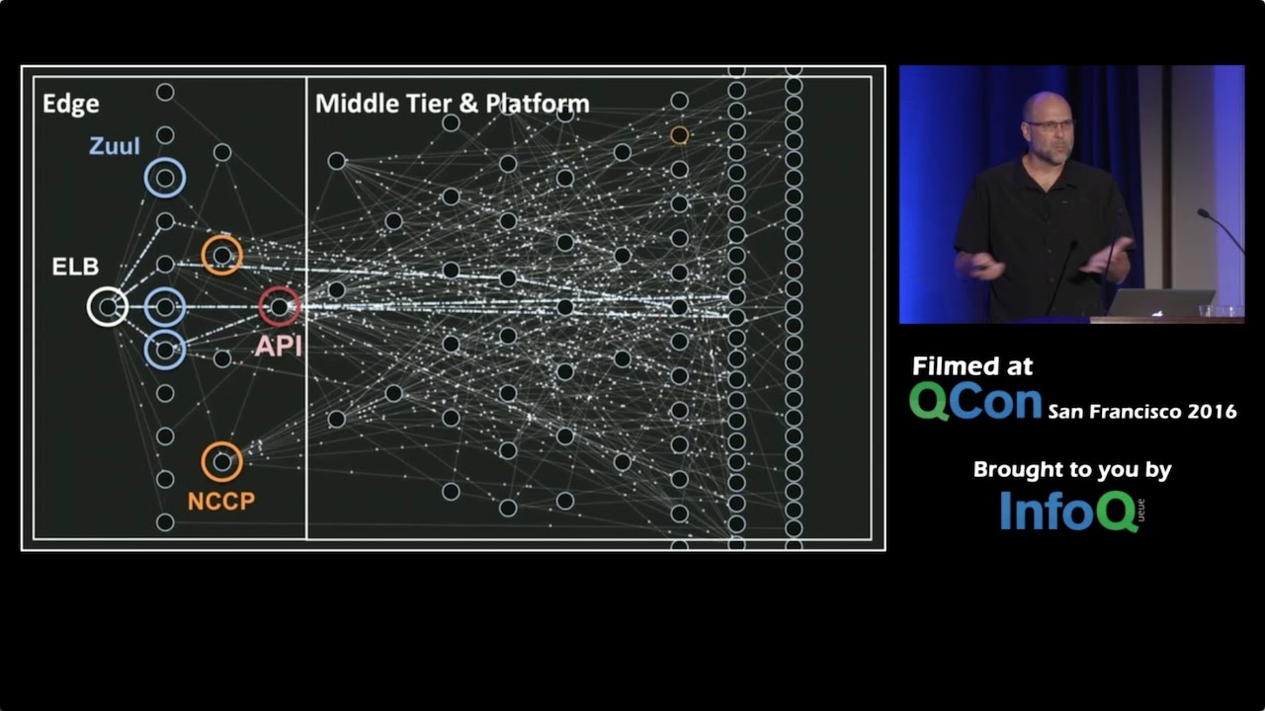
Netflix Architecture Talk

Slide 6
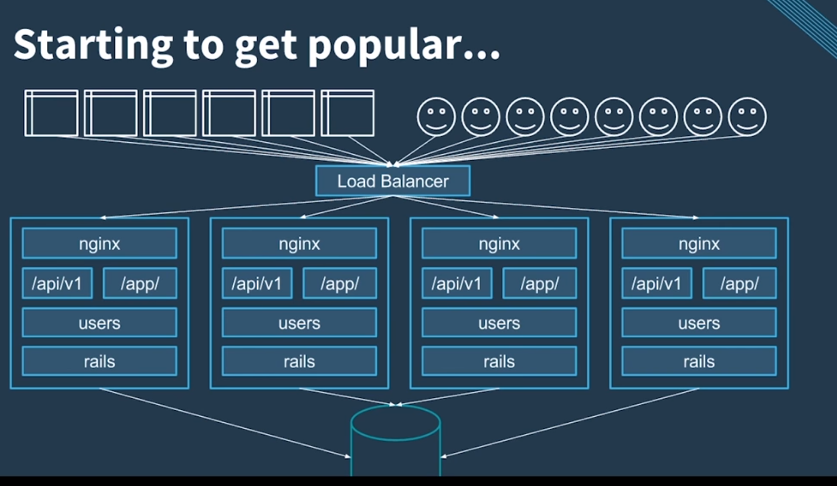
Why do we need containers?

Slide 7
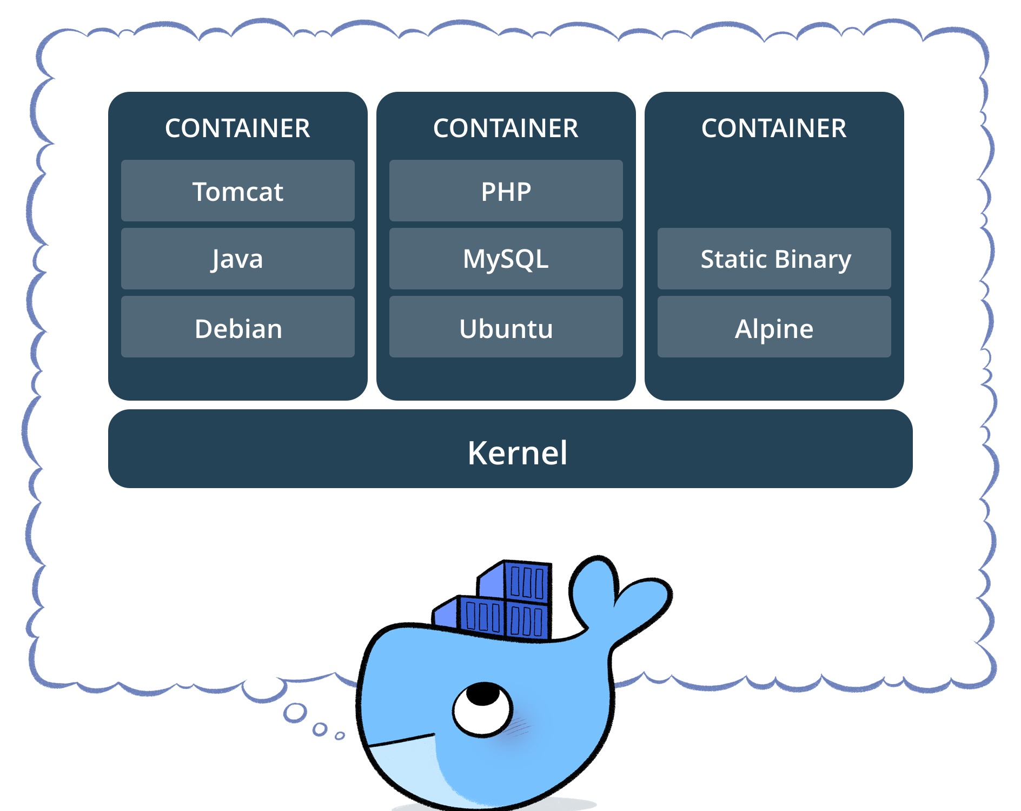
What is a Container?

Slide 8
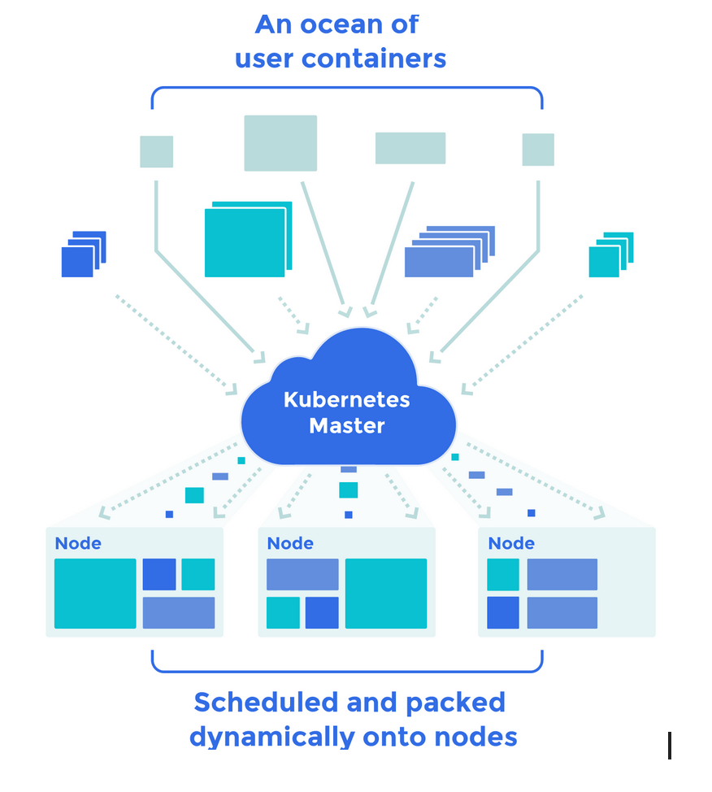
Container Orchestration

Slide 9
Docker Demo
Steps & Commands
Login into Linux system with root or sudo
yum -y install docker
Systemctl status docker, systemctl enable docker, systemctl start docker
docker search apache
docker pull fedora/apache
docker images, docker info
docker run -p 8080:80 -i -t --name=science fedora/apache /bin/bash
vi /var/www/html/index.html
httpd &
ps auxww | grep httpd
docker ps -a, docker inspect science | more
exit, docker rm science, docker ps

Slide 10
References
Docker Image
Monolithic Image
Monolithic Architecture Image
Docker and Containerization
Amazon and Netflix Microservices
Netflix Architecture Talk
Docker Demo

